Slide 1
Data Science Basics in R:
Day 4: R in the “Real World”

Slide 2
Goals for today
Learn how other people use R in their day jobs
Get familiar version control and github
Create a simple online portfolio of work
Brainstorm how you can keep using R

Slide 3
Using R at work

Slide 4

How do people use R at work?
program analysts
Program evaluations
Monitoring financial data
Annual reports/reporting
Day-to-day operations
https://www.brookings.edu/research/what-all-policy-analysts-need-to-know-about-data-science/

Slide 5
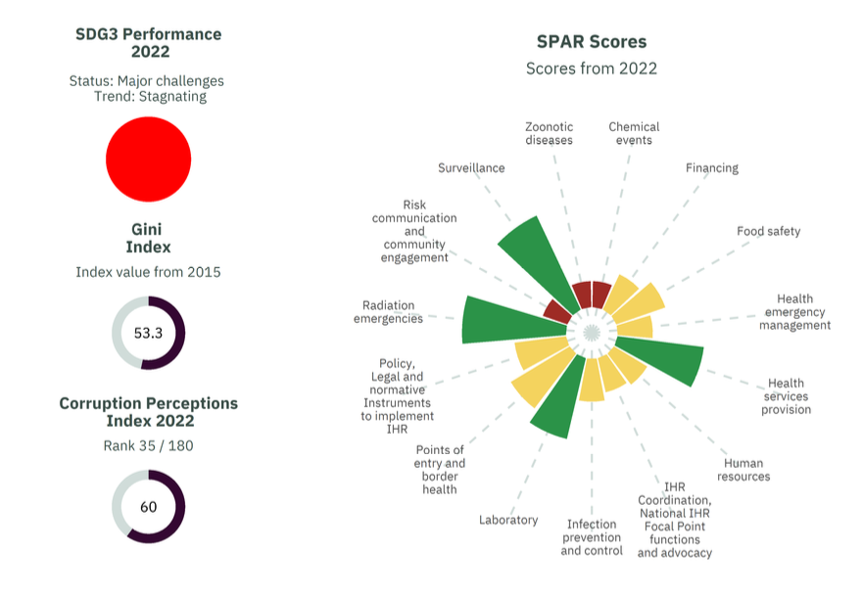
How do people use R at work?
public policy
Data visualization
Financing decisions
Data-informed policy development

Slide 6
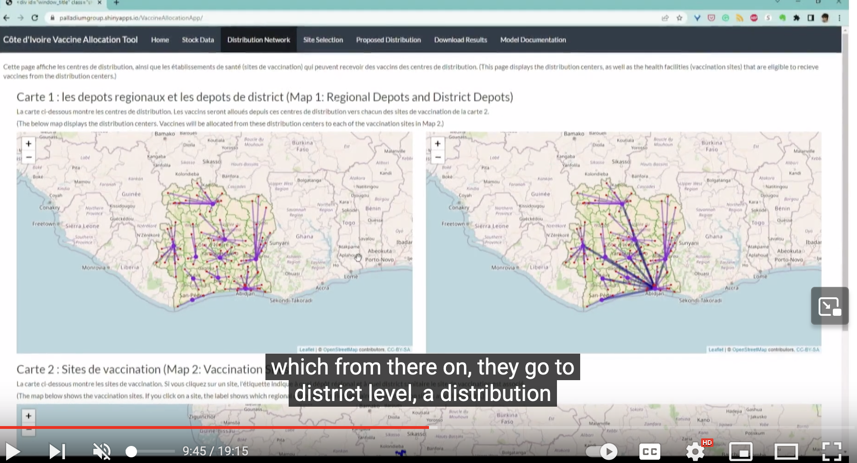
How do people use R at work?
public health and healthcare operations
Vaccine distribution
Optimizing patient flow through hospitals
Monitoring healthcare systems (e.g., standards of care, diversions)
https://www.youtube.com/watch?v=vd1Tjaqryks

Slide 7
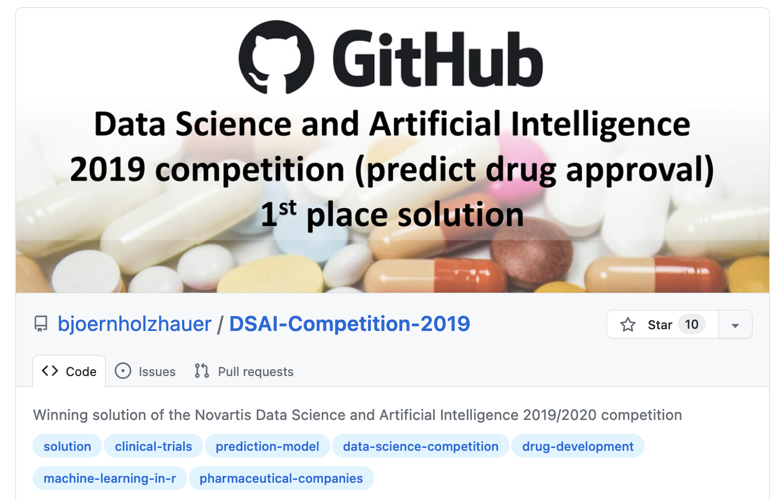
How do people use R at work?
pharmaceutical companies
Self-service tools
Patient-reported data
Drug discovery
Analysis of clinical trial data
Analysis of biological data
Regulatory submissions
https://www.youtube.com/watch?v=JwrEB9cqNqg
https://github.com/topics/machine-learning-in-r

Slide 8
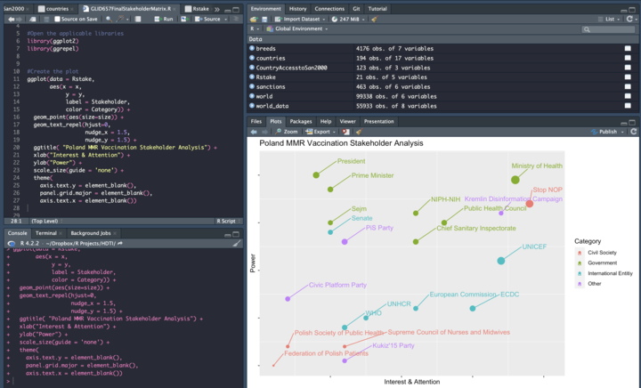
How do people use R at work?
coursework
Data analysis
Data visualization
Reporting

Slide 9
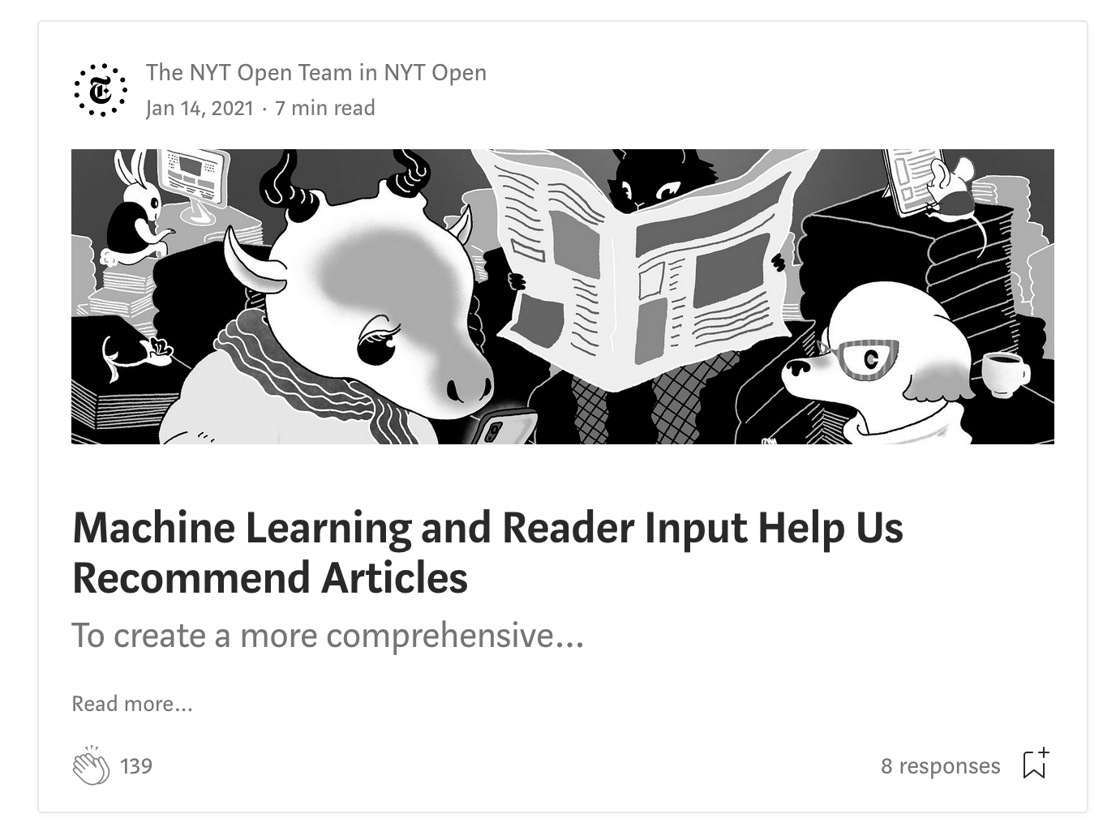
How do people use R at work?
journalism
Data investigation
Data-driven journalism
Data visualizations
Subscriber retention
Revenue optimization
Recommendations
https://open.nytimes.com/tagged/data-science

Slide 10

How do people use R at work?
other stuff
https://open.nytimes.com/tagged/data-science

Slide 11
Version control and github

Slide 12
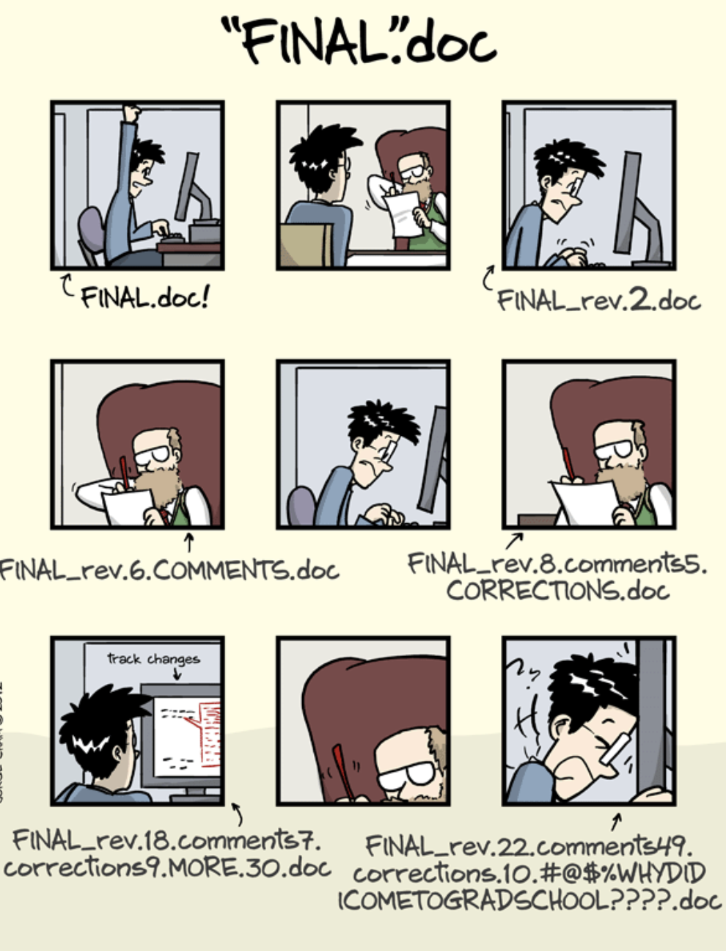
PHD comics

Slide 13
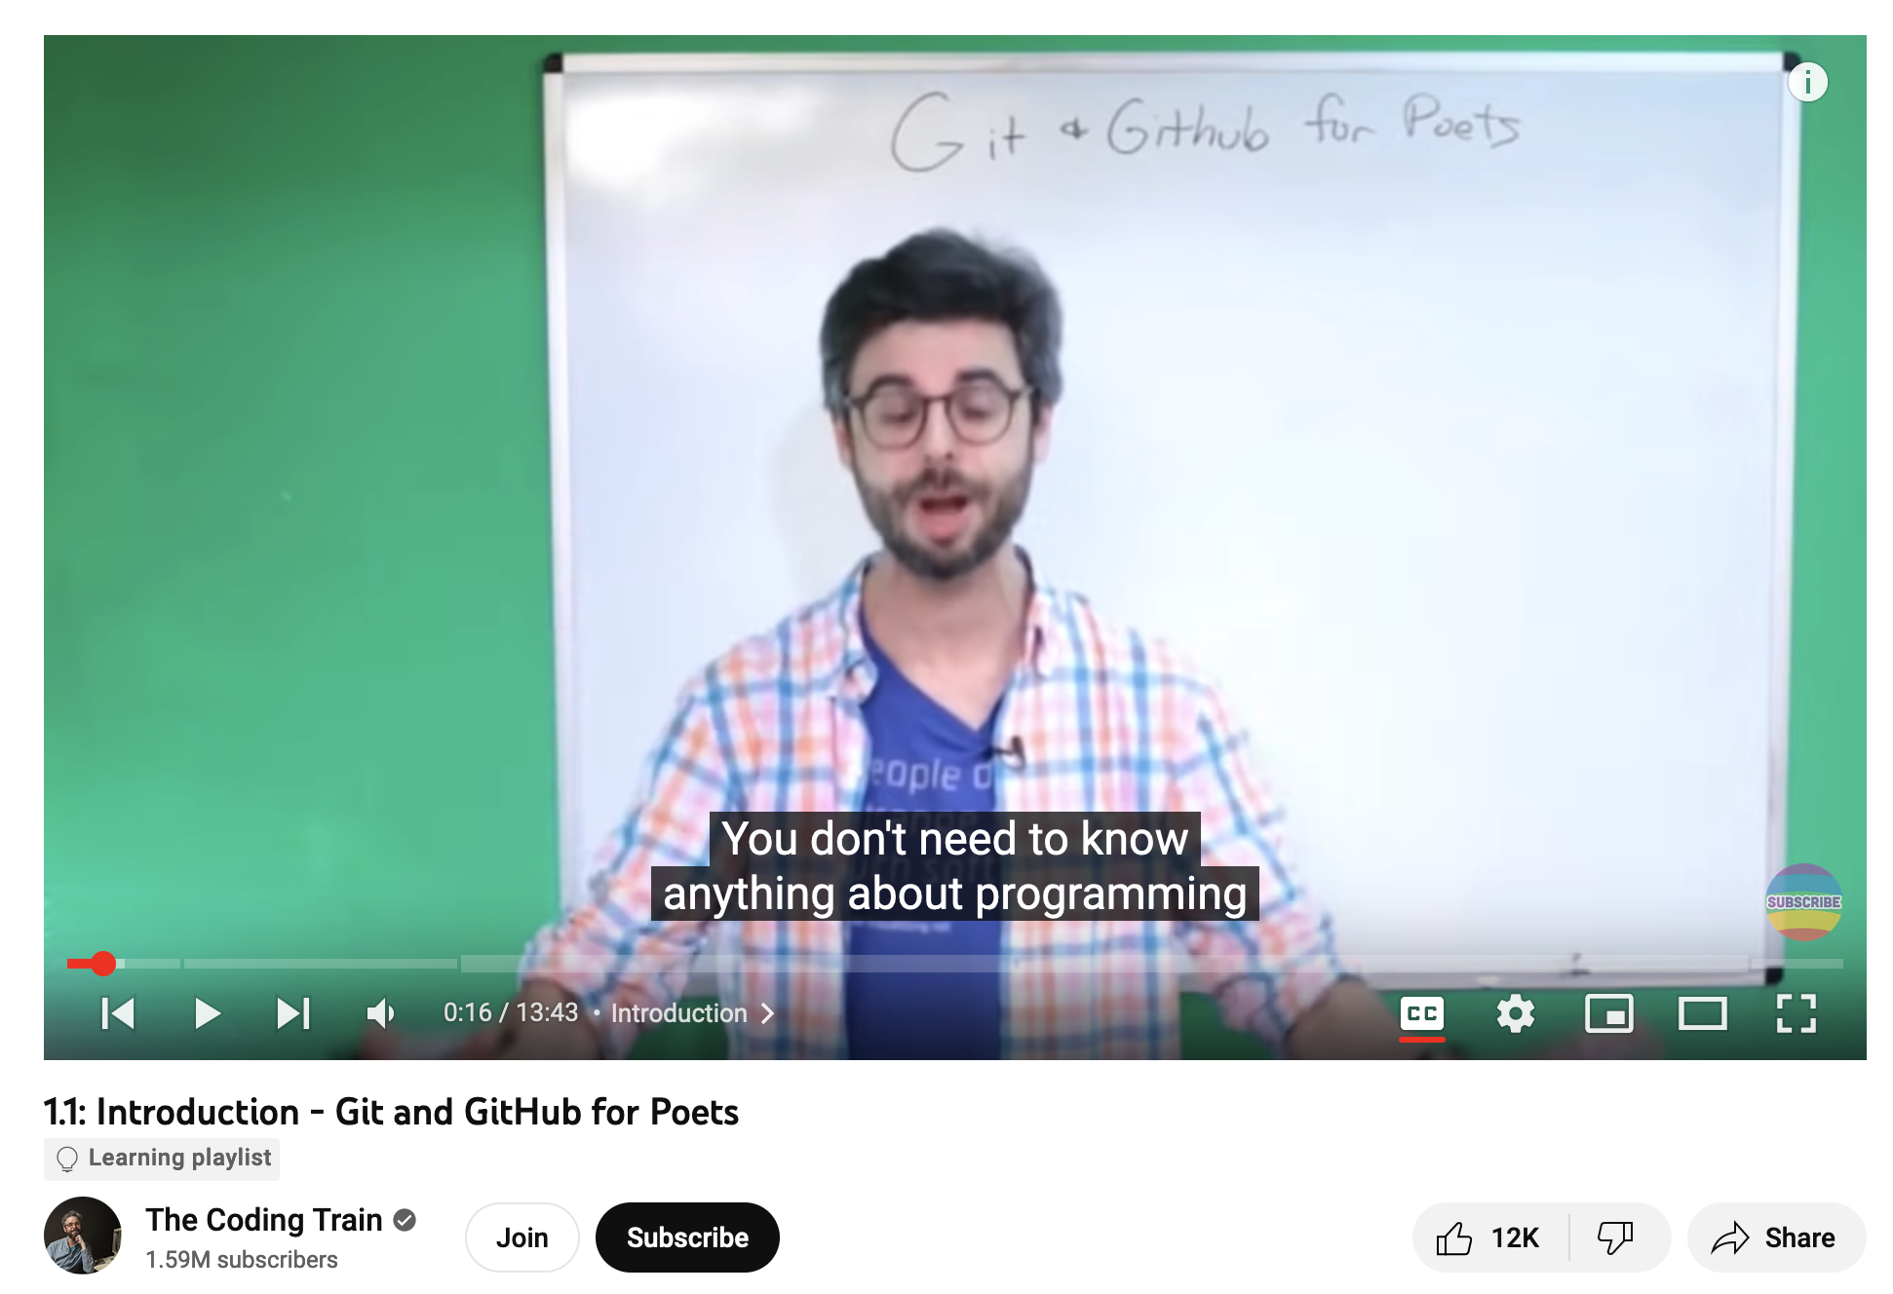
Github for poets
https://www.youtube.com/watch?v=BCQHnlnPusY&list=PLRqwX-V7Uu6ZF9C0YMKuns9sLDzK6zoiV&index=1

Slide 14
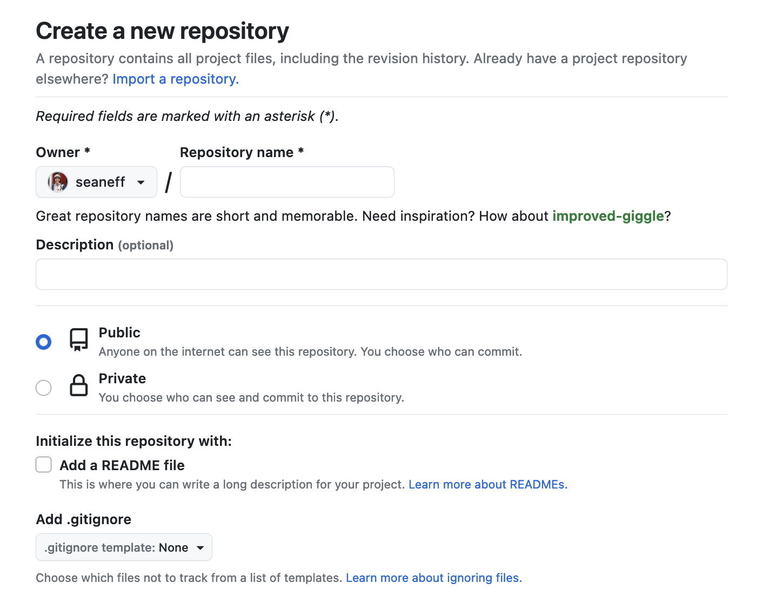
Your first github repo

Slide 15
Forking a repository
Put simply, forking a repository is a way to copy (and work with) public files that someone else has shared
Useful to collaborate with others
Useful to keep track of important things
Useful to take code and then modify it yourself

Slide 16
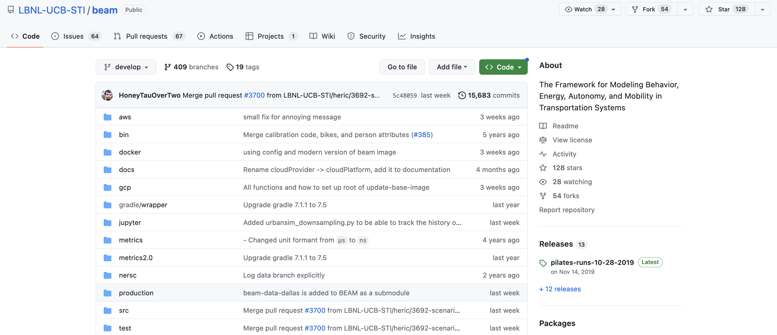
Forking a repository

Slide 17
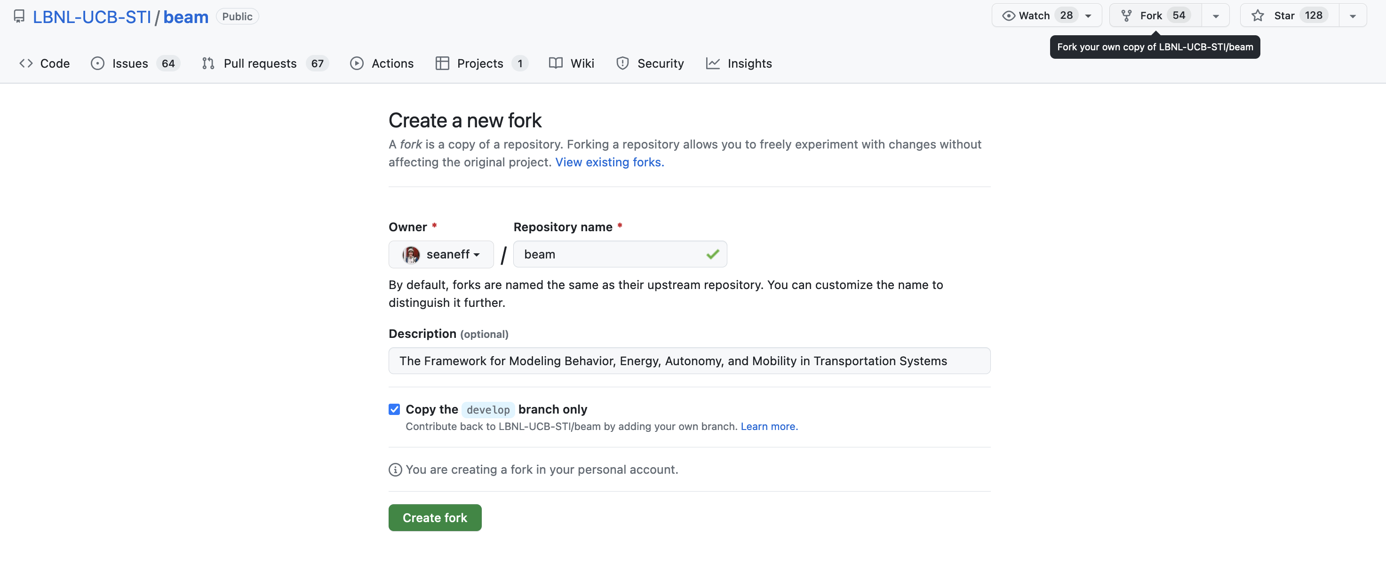
Forking a repository

Slide 18
Forking a repository

Slide 19
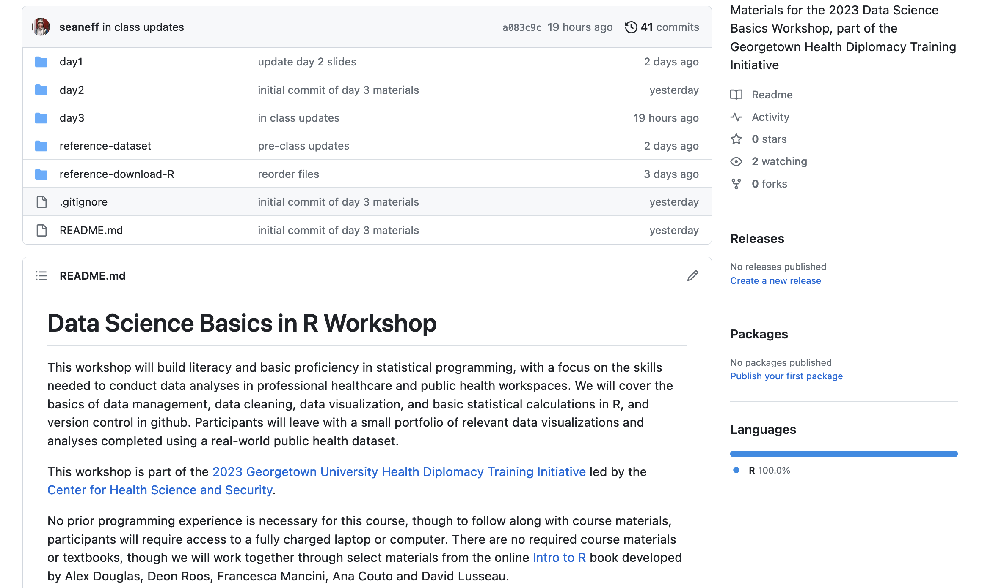
Forking a repository
https://github.com/seaneff/data-science-basics-2023

Slide 20
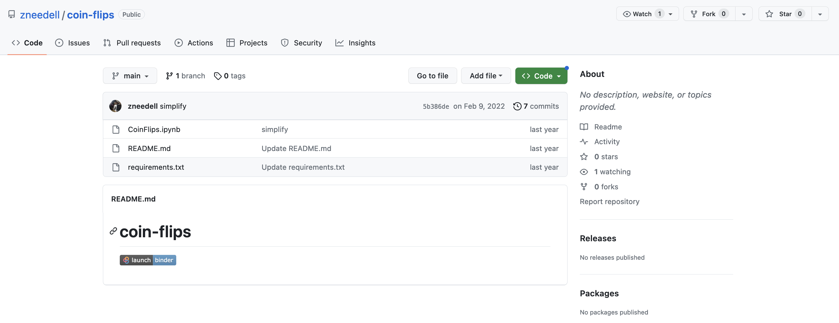
Watching a repository
https://github.com/seaneff/data-science-basics-2023

Slide 21
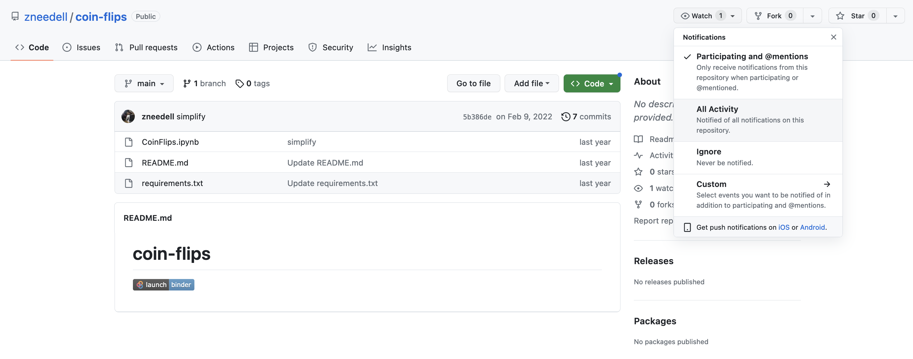
Watching a repository
https://github.com/seaneff/data-science-basics-2023

Slide 22
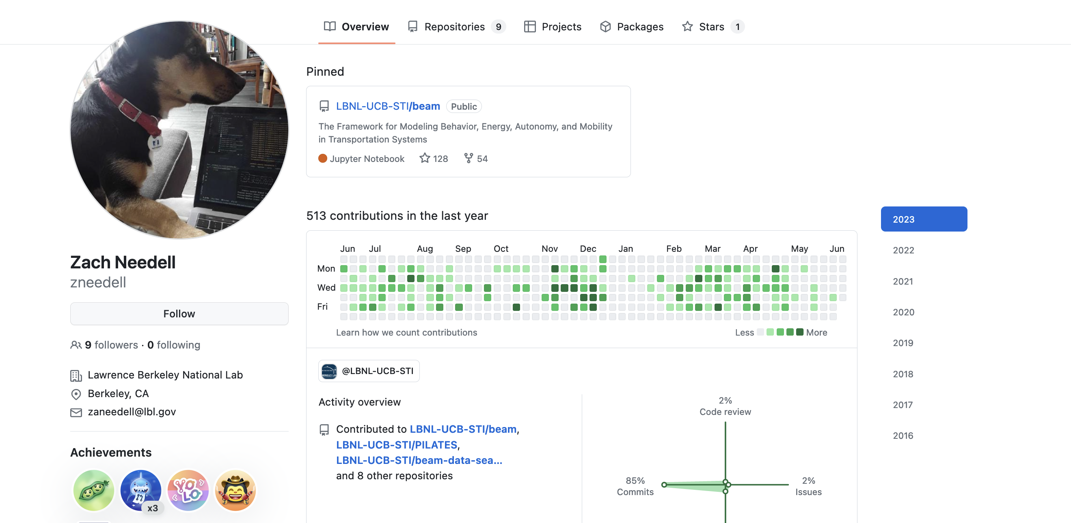
Following a user

Slide 23
Where to learn more

Slide 24
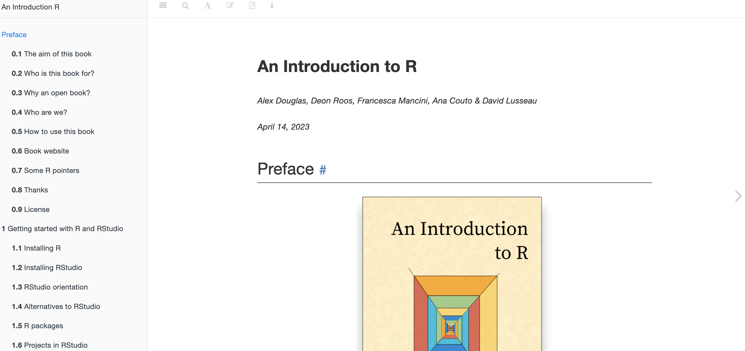
https://intro2r.com

Slide 25
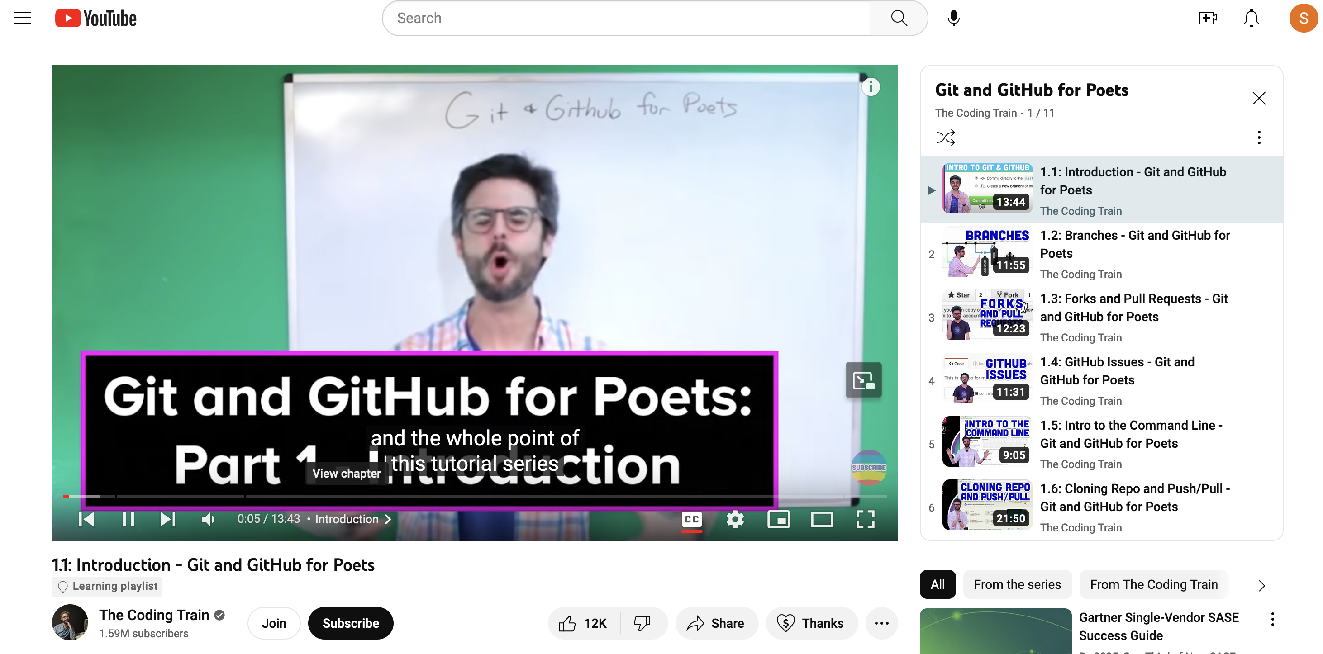
Github for poets

Slide 26
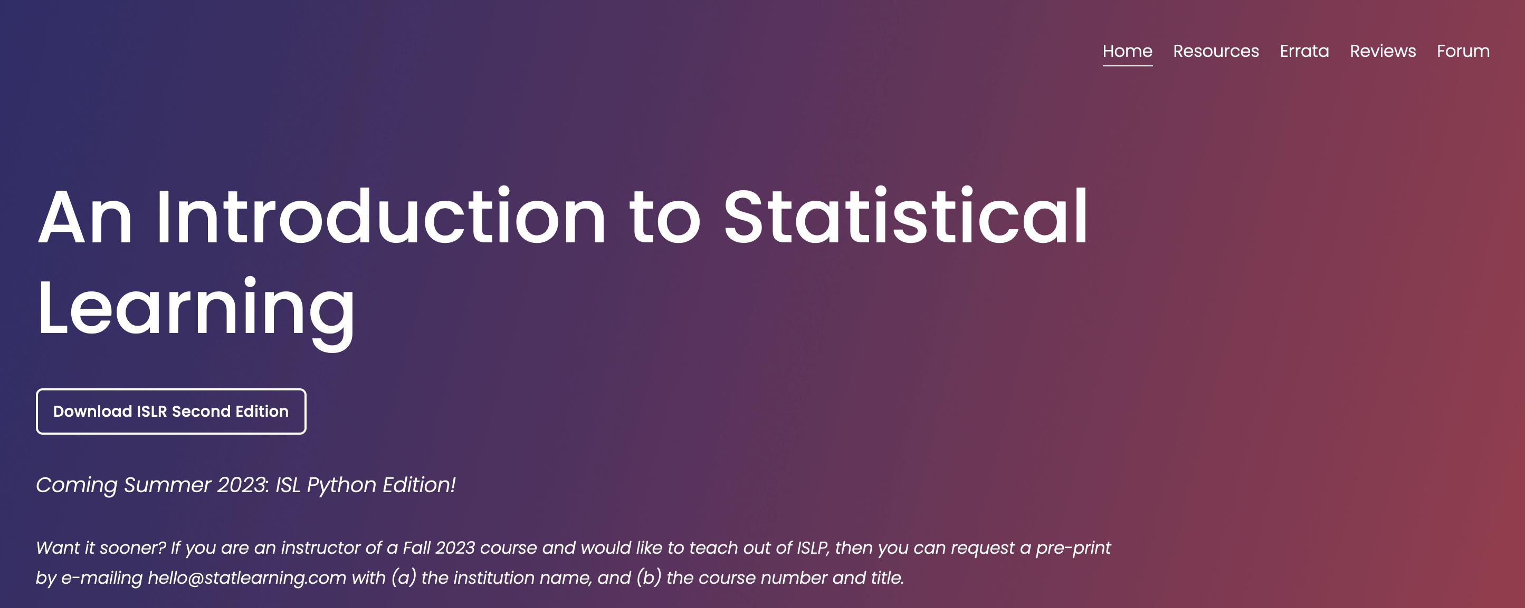
https://www.statlearning.com/

Slide 27
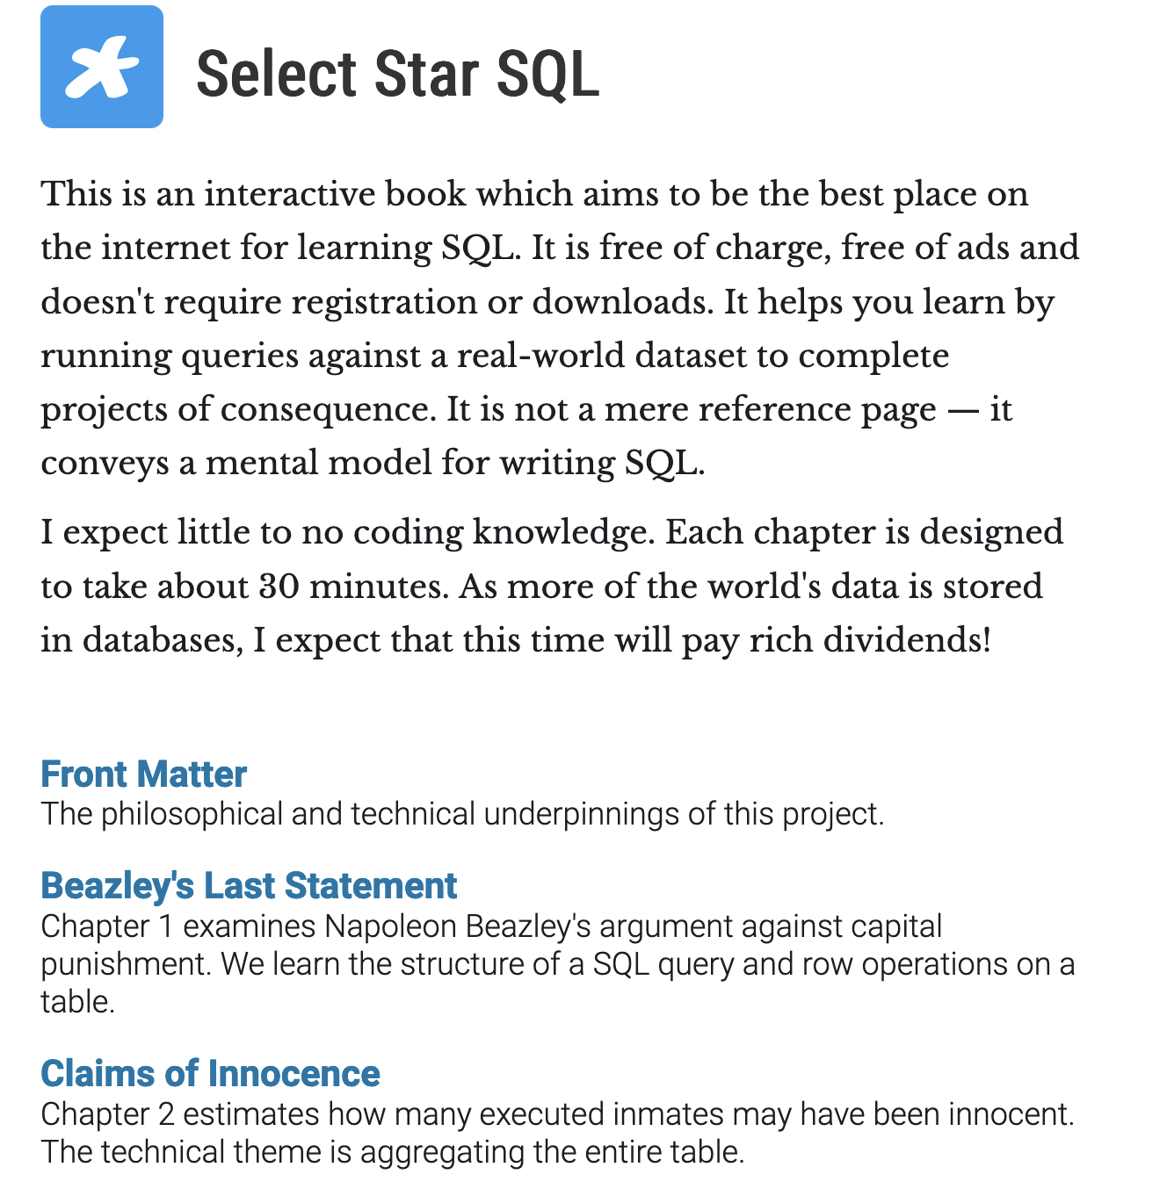
https://selectstarsql.com/

Slide 28
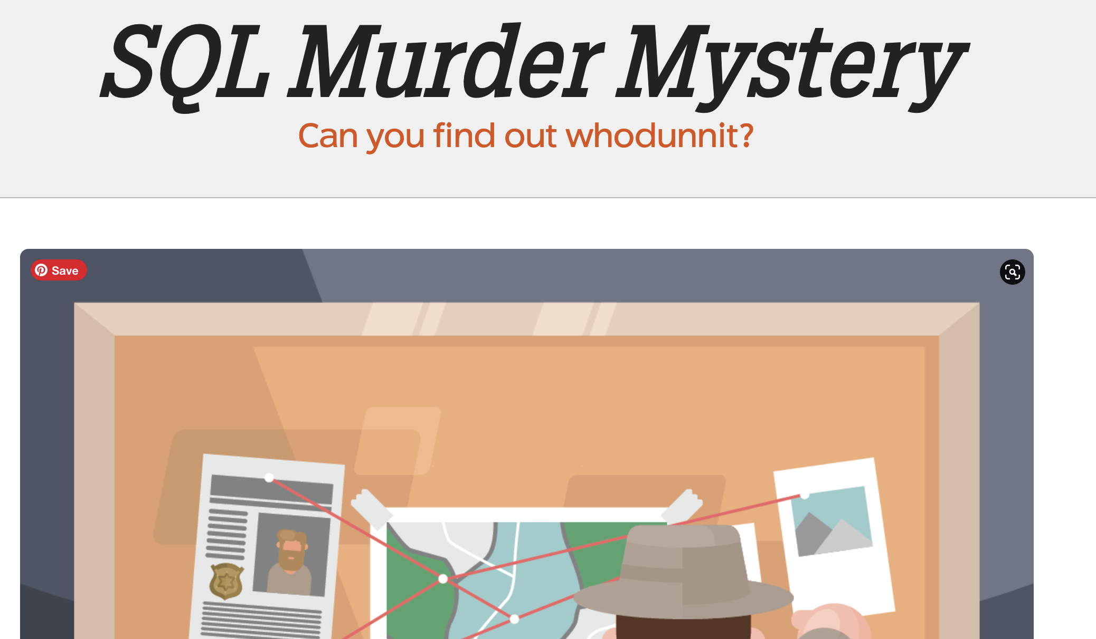
https://mystery.knightlab.com/

Slide 29
How to get good at R
(or python, or SQL, github, or…)
Use R, and use it often
Use R when you could use Excel, even if it takes longer
Consider a fun personal project
Follow others on github and check out what they’re doing

Slide 30
Thank you!
Please stay in touch.
sde31@georgetown.edu
https://www.linkedin.com/in/seaneff/
Lecture and course material adapted from Intro to R materials created by Alex Douglas, available online here, with corresponding free online textbook.

